Slide 1

Design, Develop, Implement, Test Document Used Car Sales Portal Website
Module Project
Module: Application Development & Process
Course: Applied Degree in Software Engineering
Start Date :
End Date :
Submission Date :
Learner Name :
Enrollment ID :
Presentation Date :
21 November 2022
Wildan Luqmanul Hakim
13 December 2022
BDSE04-0322/STTB
13 December 2022

Slide 2
Document History
Version Number | Effective Date of release | Summary of Included Changes | Author
1 | 18 Nov 22 | First Edition | Nilofar

Slide 3
Contents
S. No. | Description
01 | Project background, objective & deliverables
02 | List of software used
03 | Business Process
04 | Project Plan
05 | Stages of Risk Based Testing models
06 | Types of risks
07 | Risk Based Testing Strategies
08 | Qualitative and Quantitative Risk Analysis
09 | Security Testing
10 | Test plans and Test cases
11 | Logs of Test Results
12 | Modifications of fail Test Cases
13 | Effectiveness of RBT strategy
14 | Project Results

Slide 4
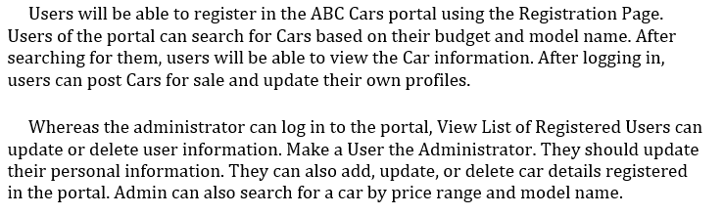
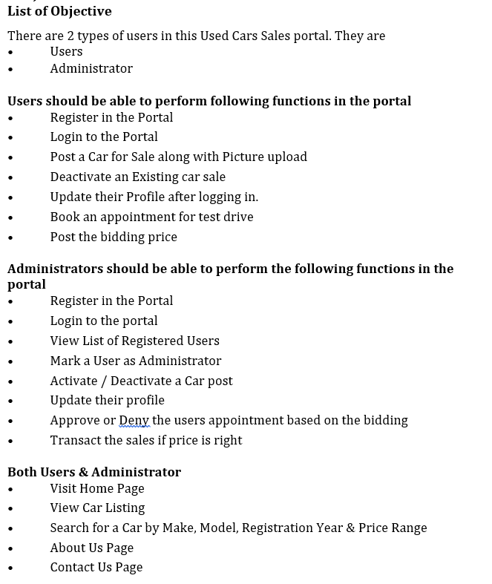

1. Project Definition
Project Background
Project Derivables
Project Objective

Slide 5
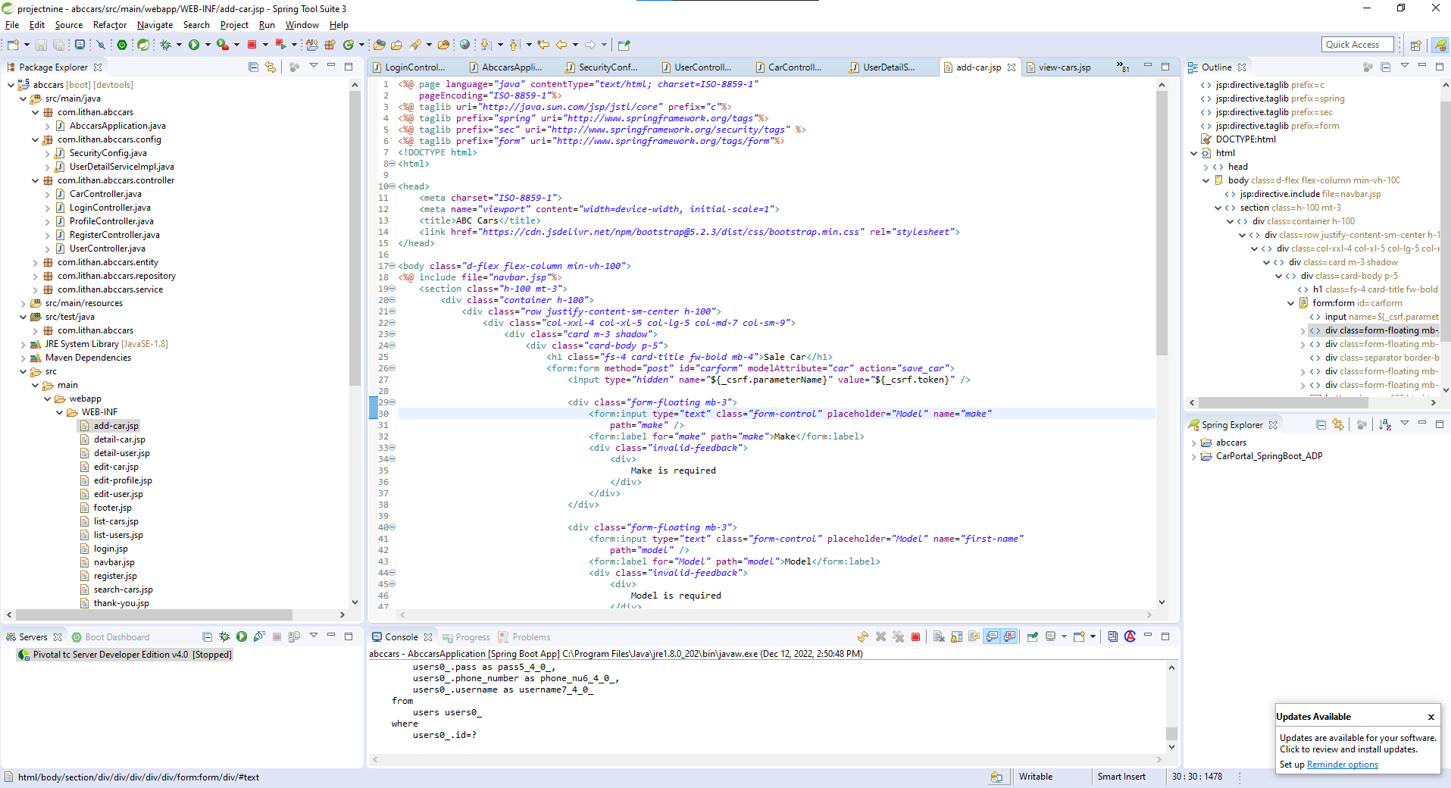
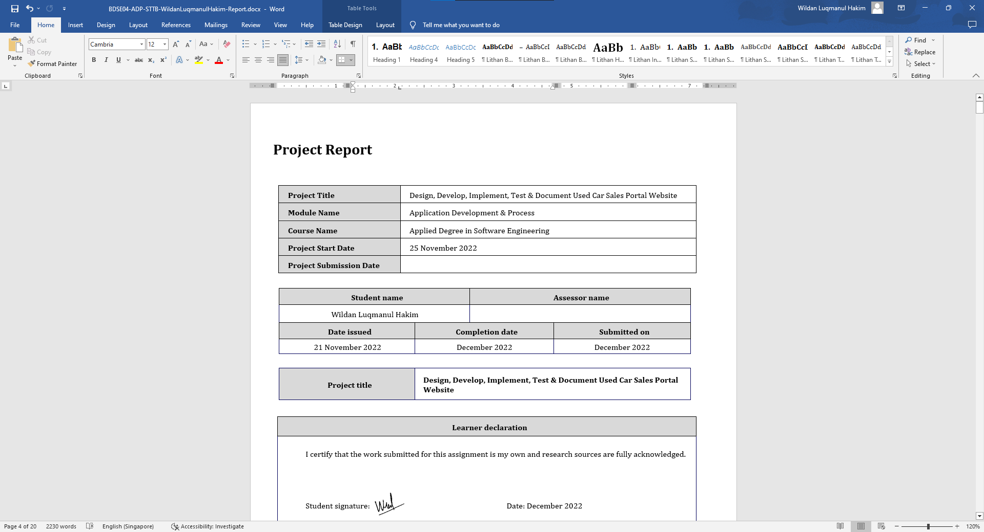
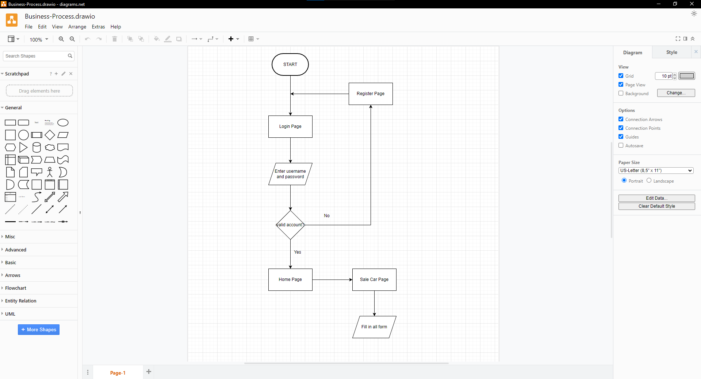
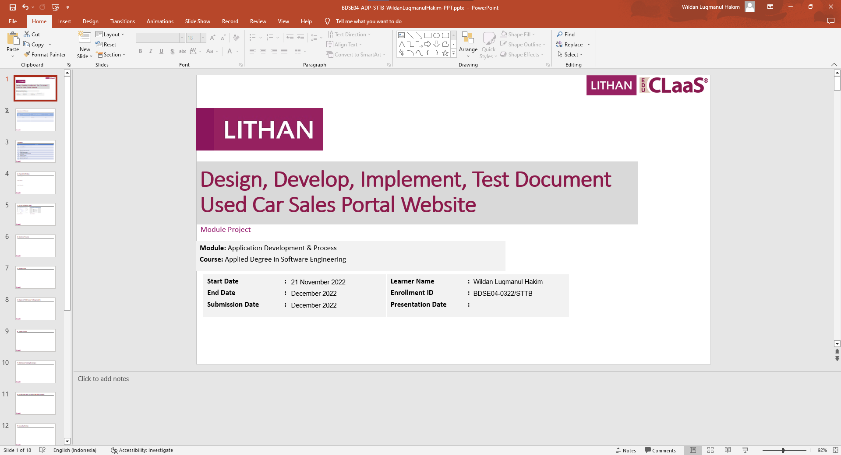
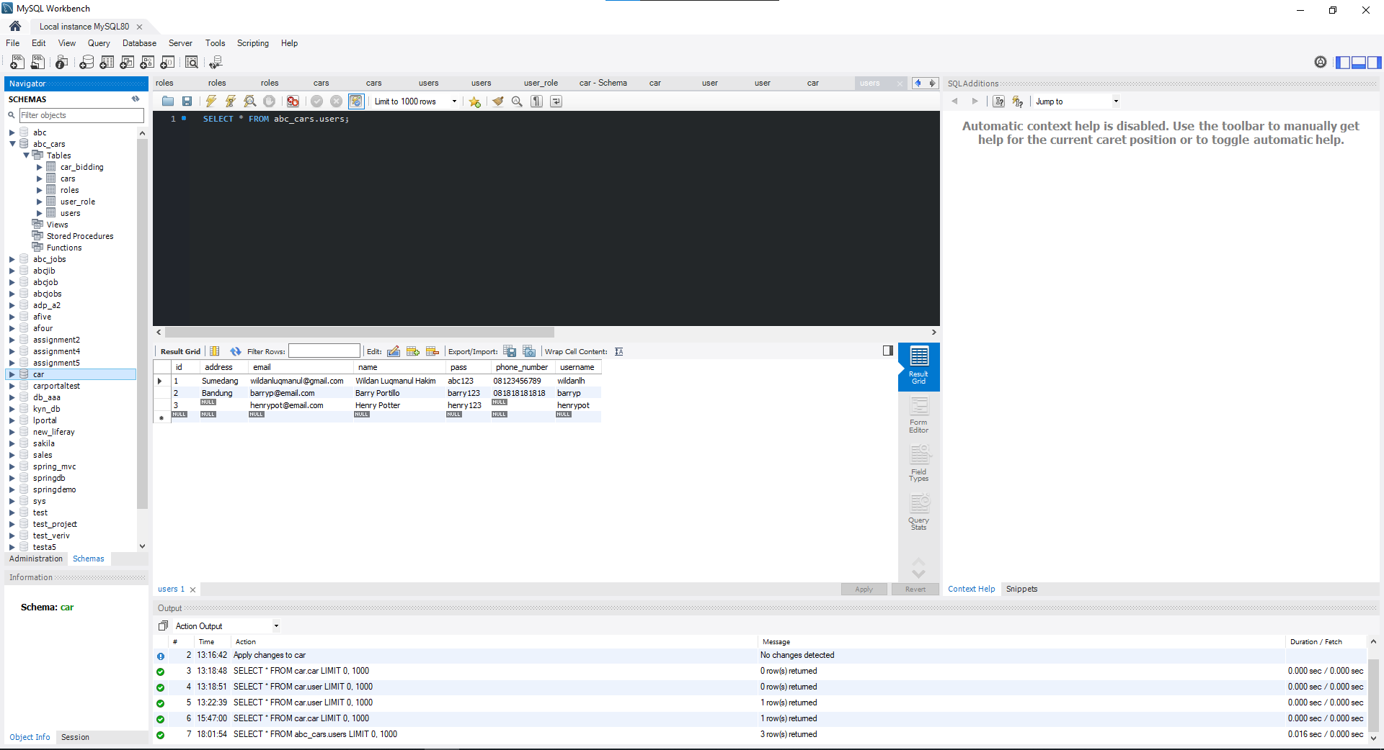
2. List of software used
Spring Tools Suits
Microsoft Word
Draw.io
Microsoft Power Point
MySQL Workbench 8.0

Slide 6
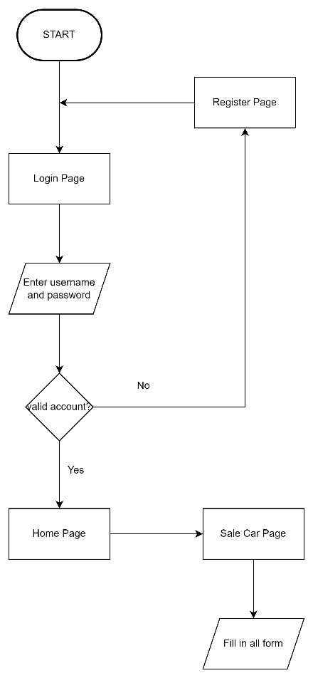
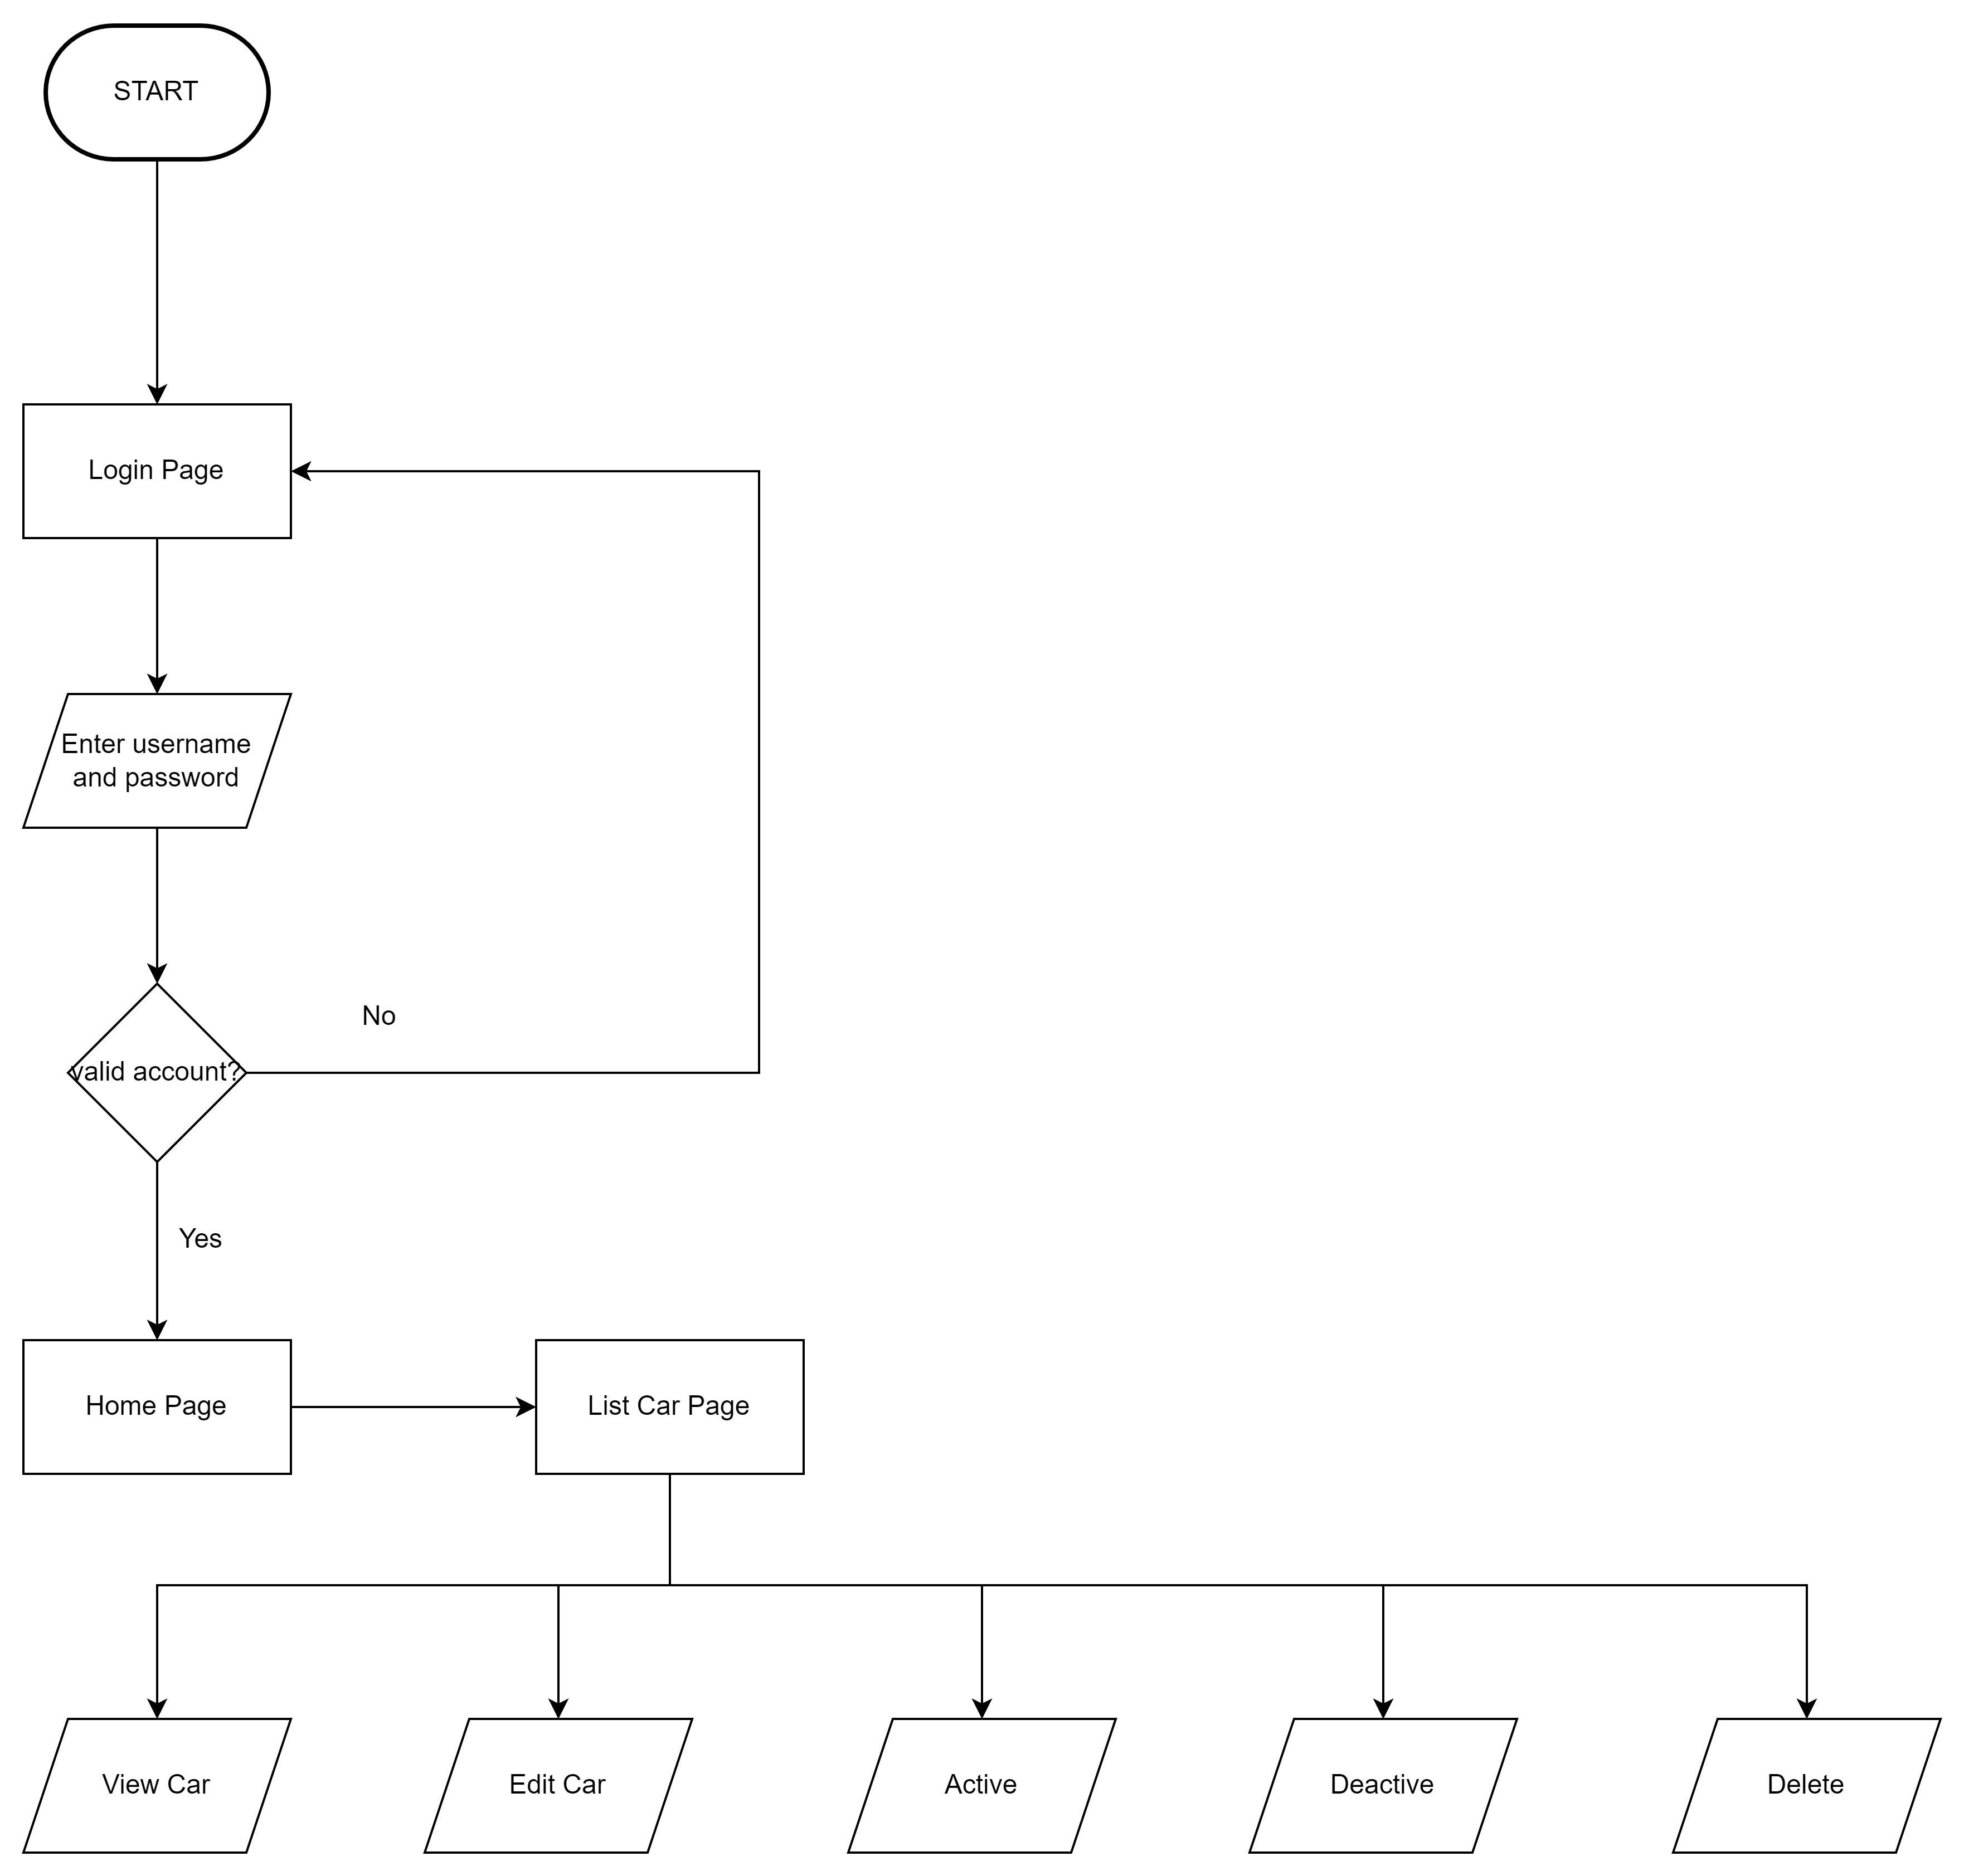
3. Business Process
Post Car
Manage Car

Slide 7
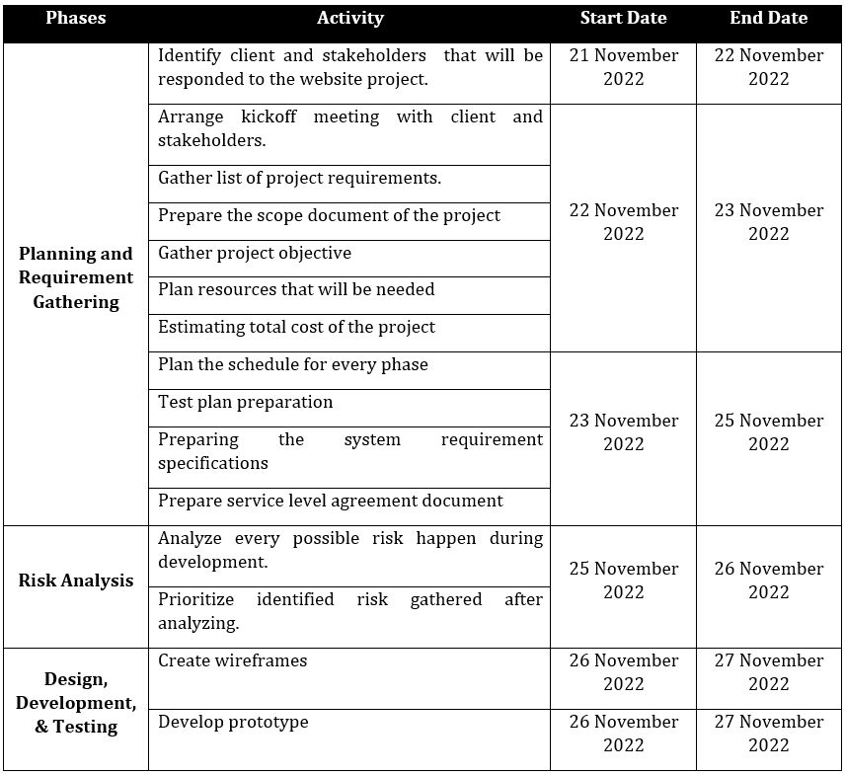
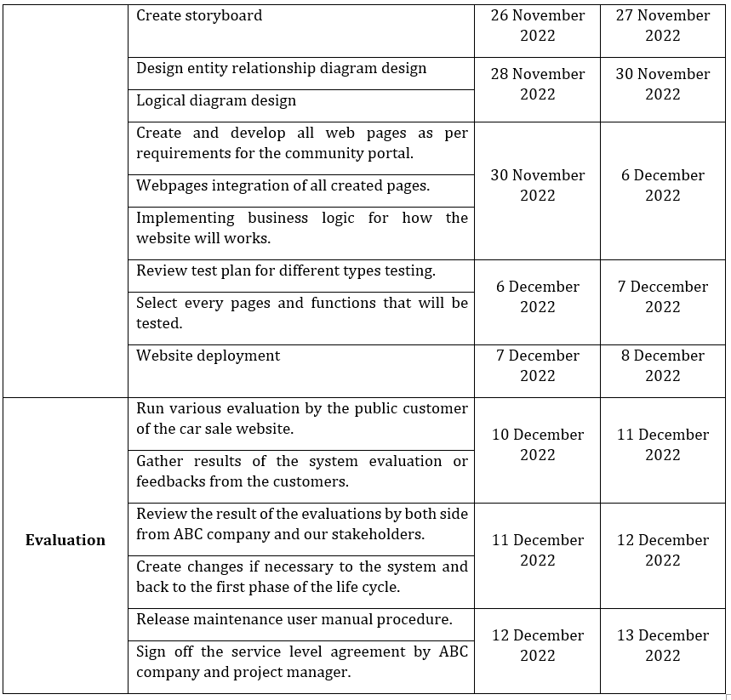
4. Project Plan

Slide 8
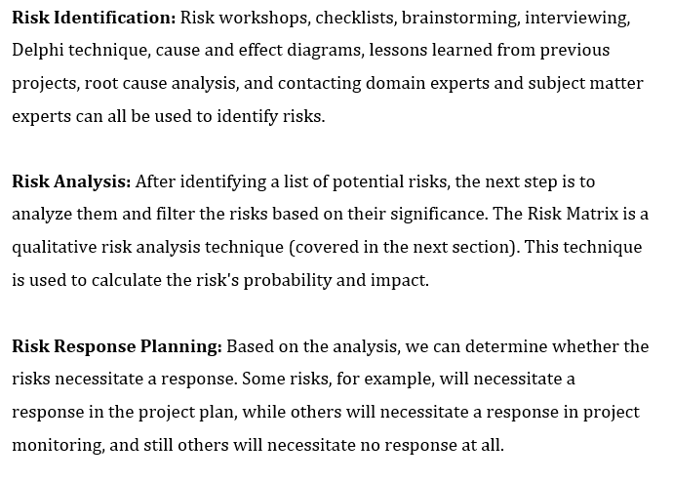
5. Stages of Risk Based Testing models

Slide 9
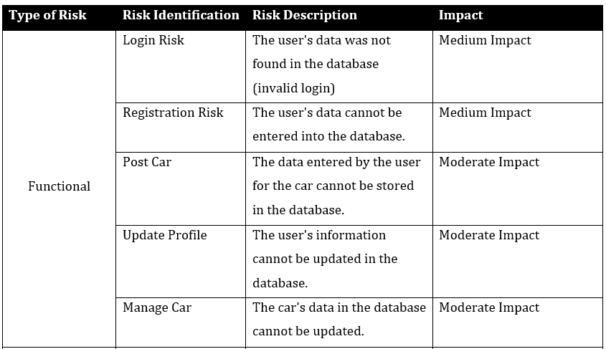
6. Types of risks

Slide 10
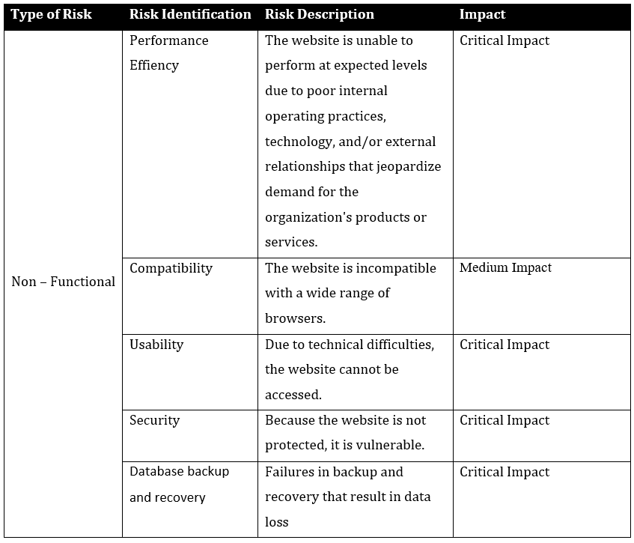
6. Types of risks

Slide 11

7. Risk Based Testing Strategies

Slide 12
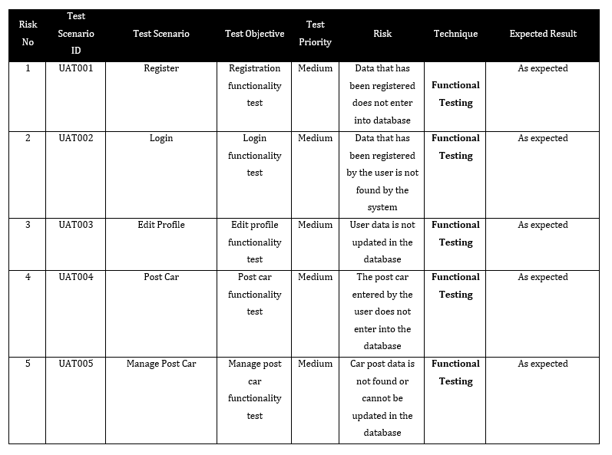
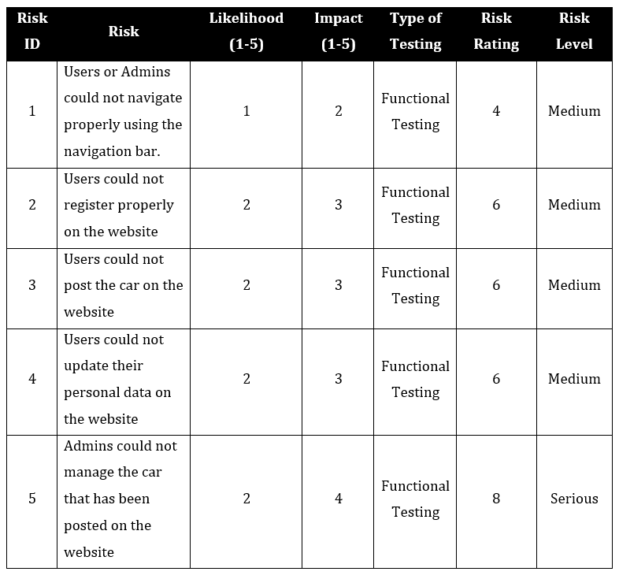
8. Qualitative and Quantitative Risk Analysis

Slide 13
9. Security Testing

Slide 14
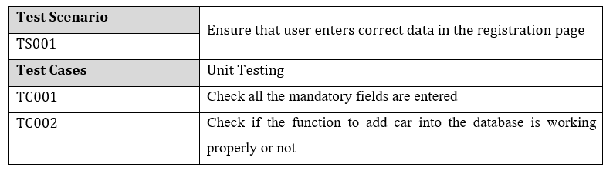
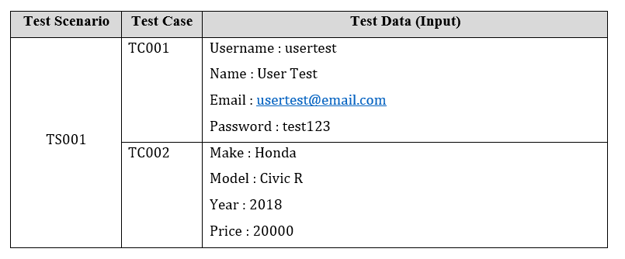
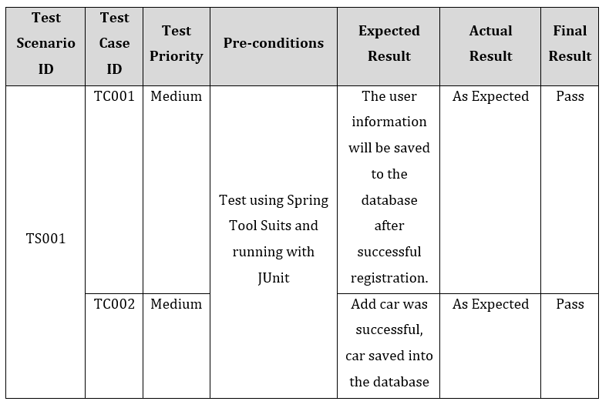
10. Test plans and Test cases

Slide 15
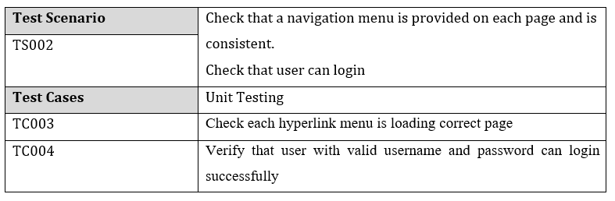
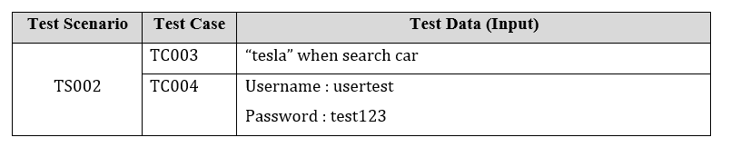
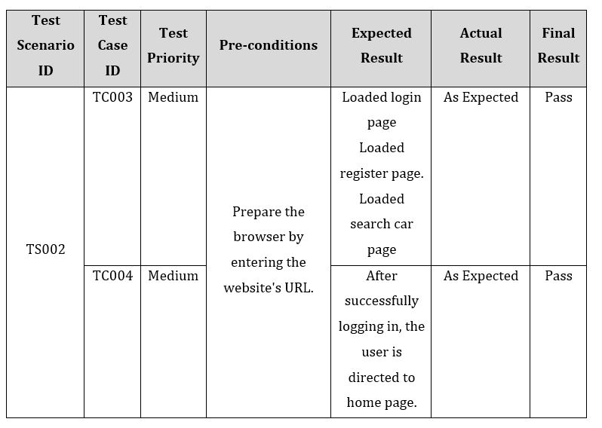
10. Test plans and Test cases

Slide 16
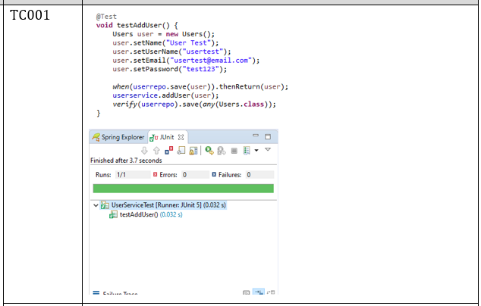
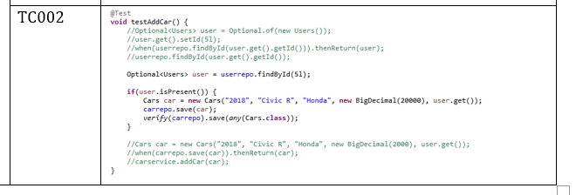
11. Logs of Test Results

Slide 17
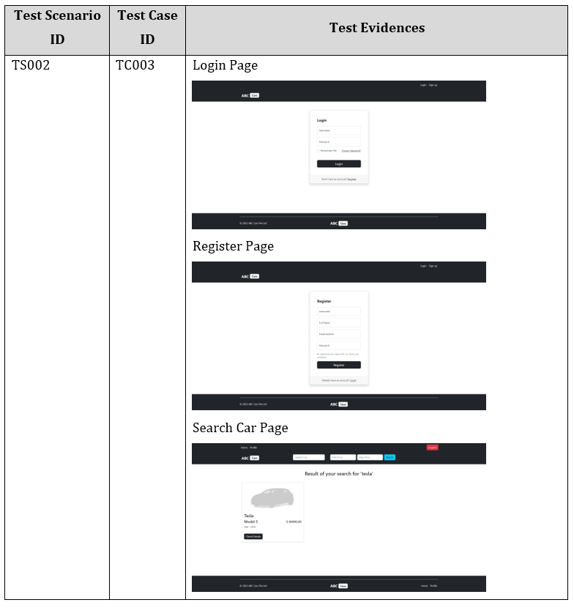
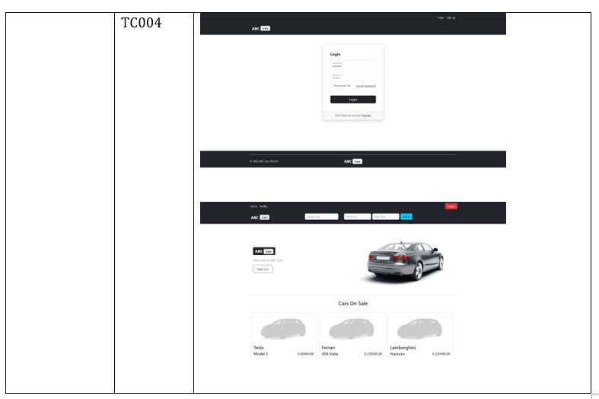
11. Logs of Test Results

Slide 18
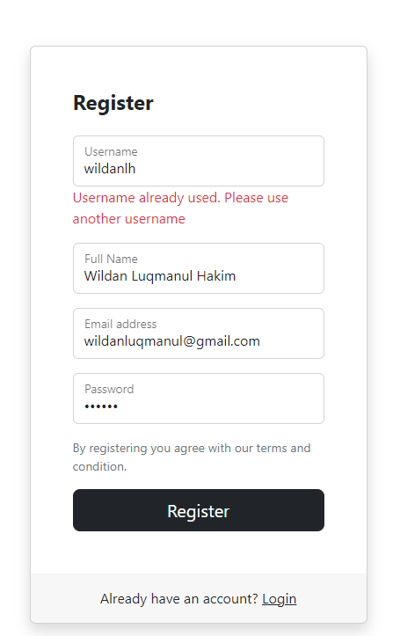
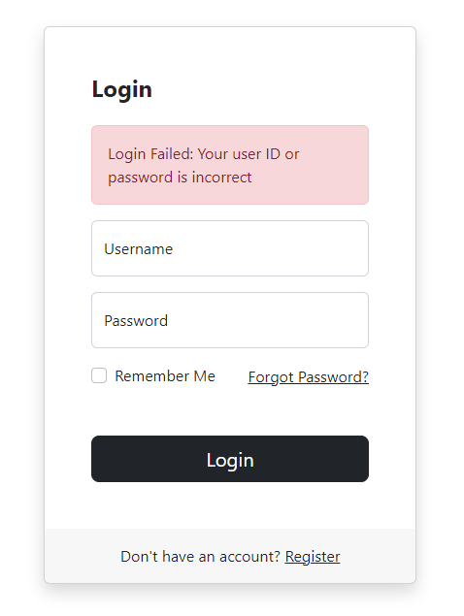
12. Modifications of fail Test Cases

Slide 19
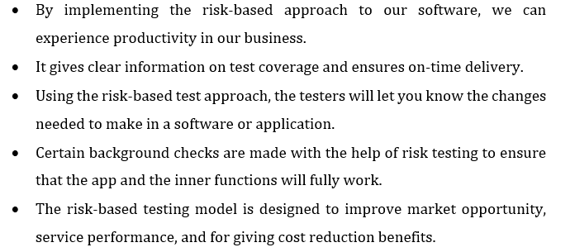
13. Effectiveness of RBT strategy

Slide 20
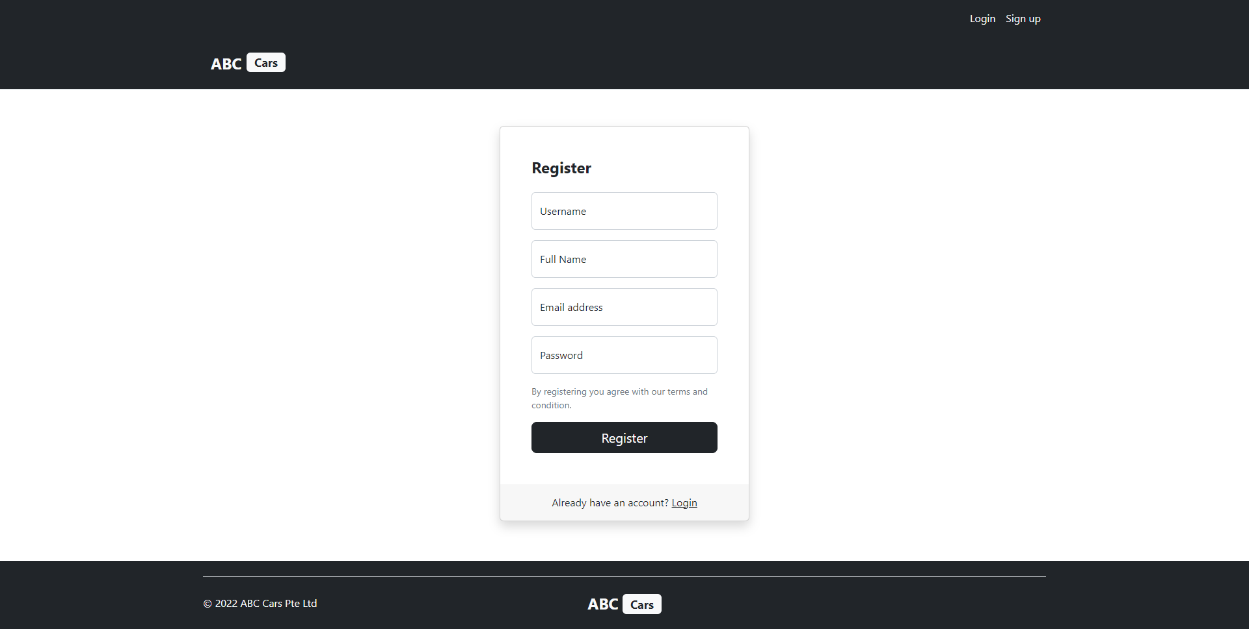
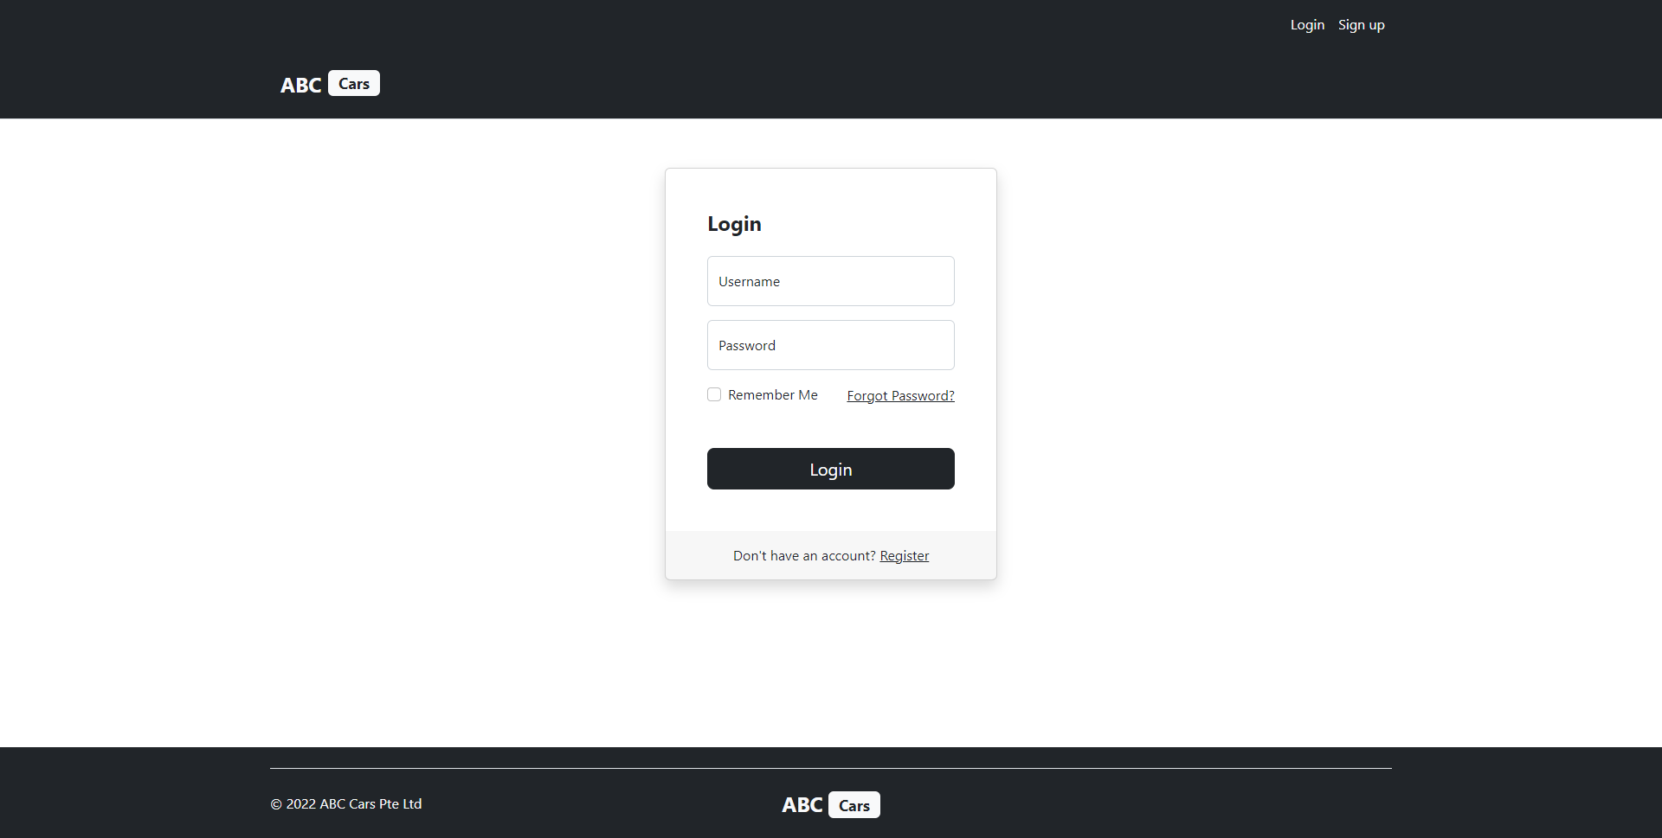
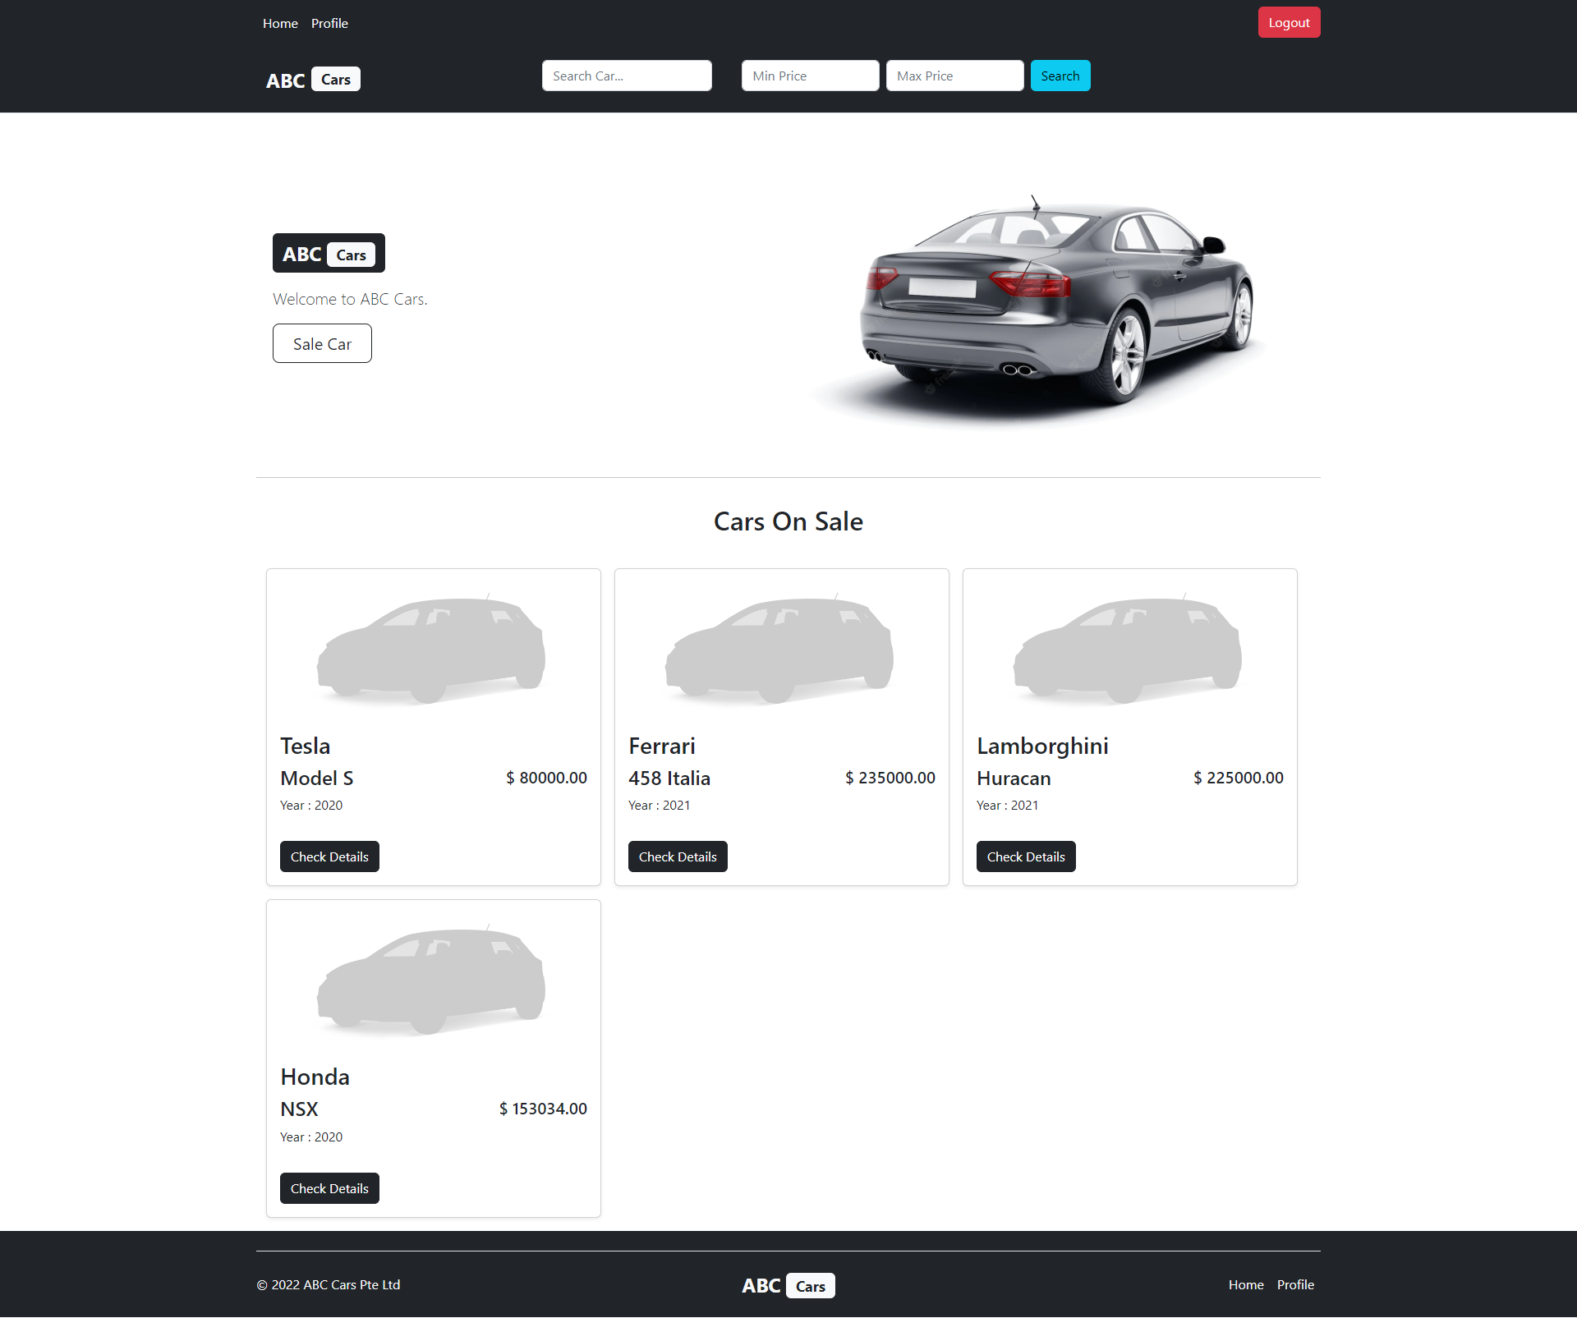
14. Project Results
Register Page
Login Page
Home Page

Slide 21
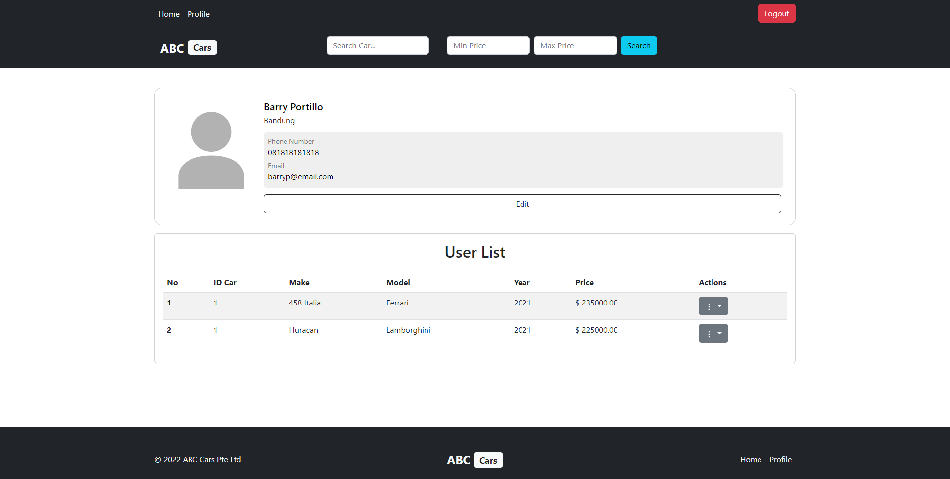
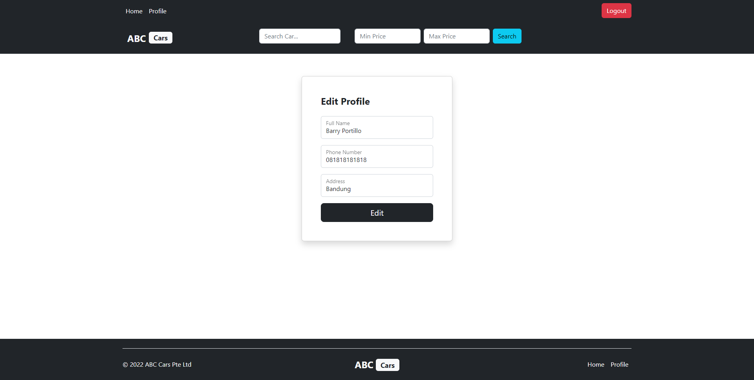
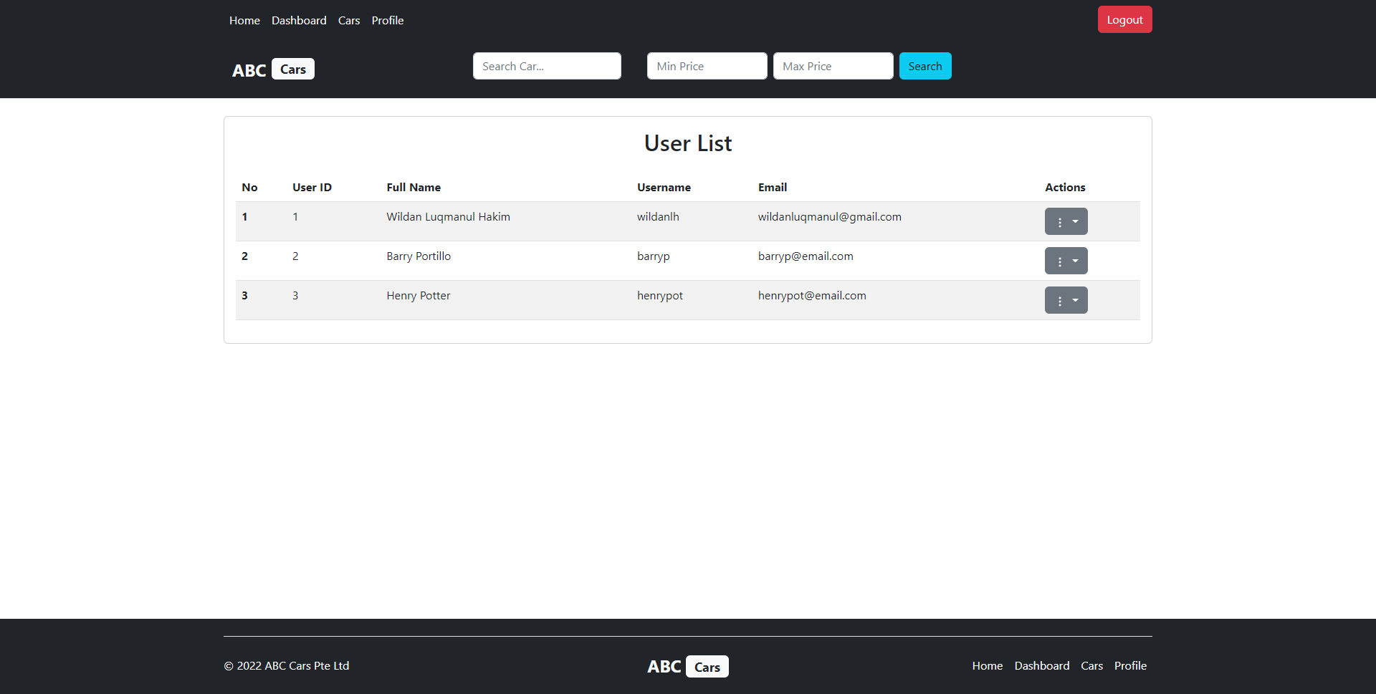
14. Project Results
Profile Page
Edit Profile Page
User List Page

Slide 22
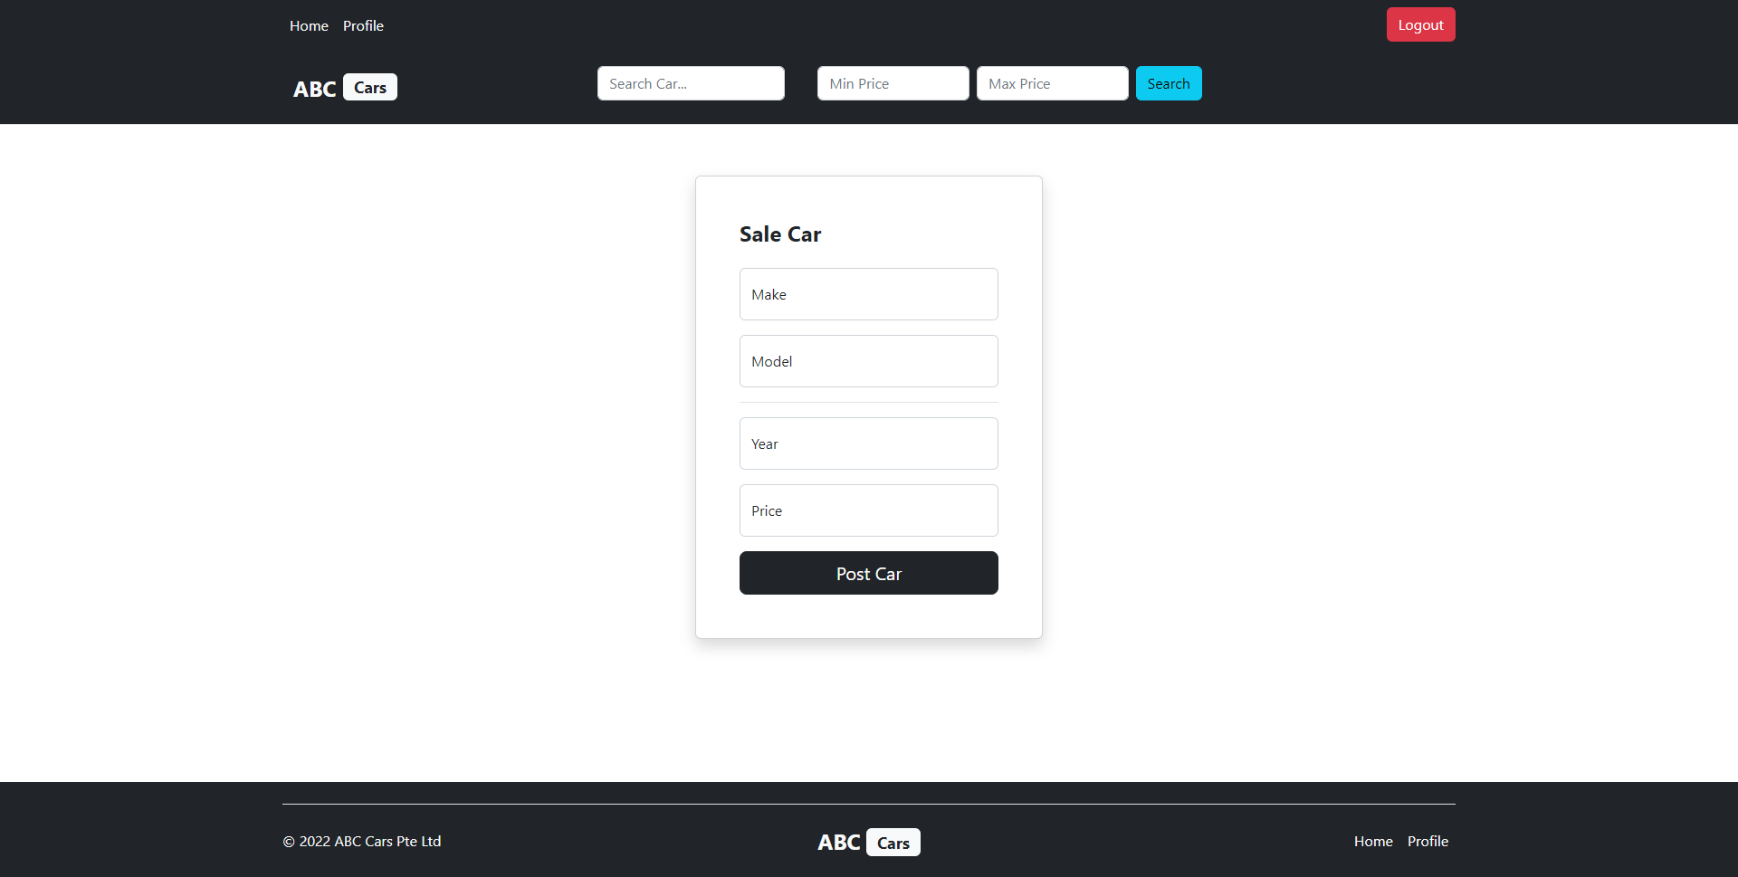
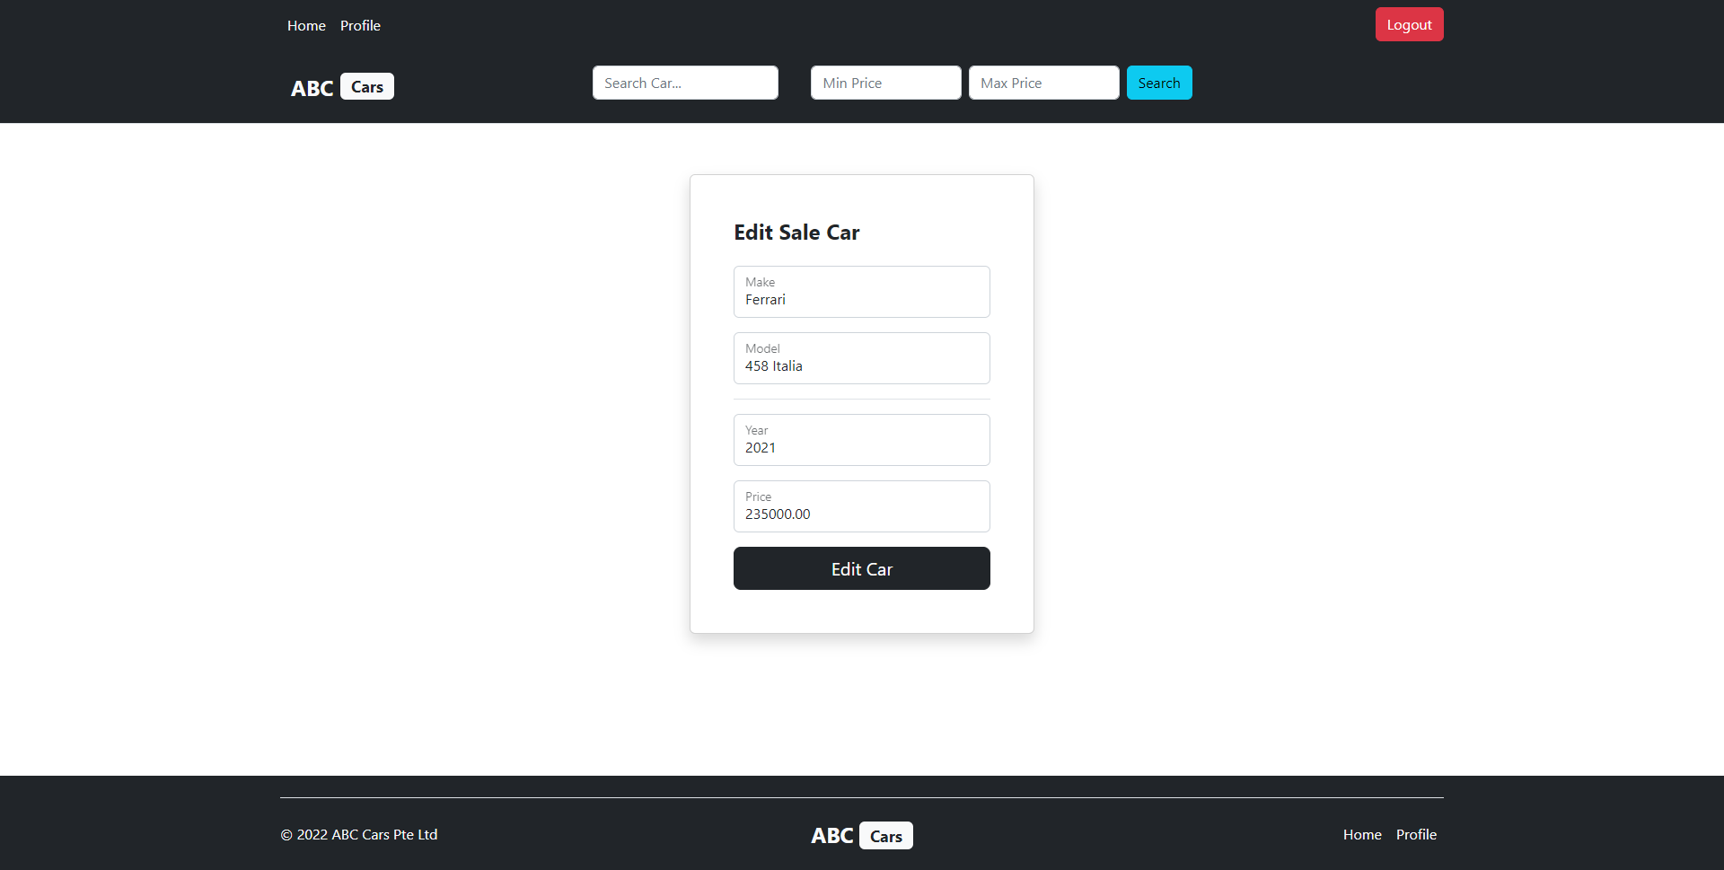
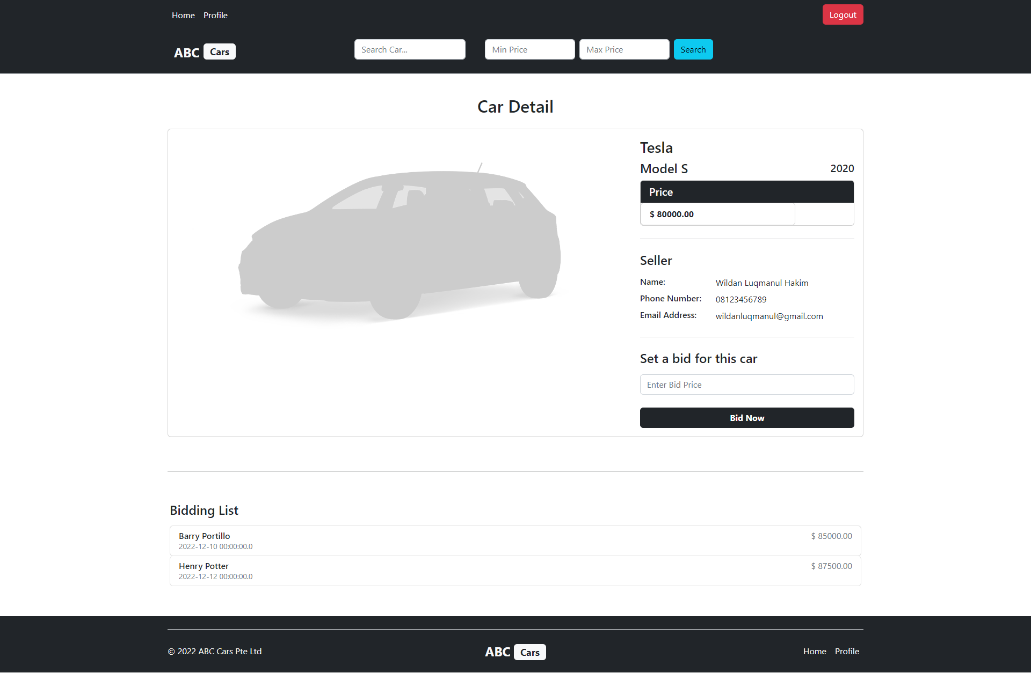
14. Project Results
Post Car Page
Edit Post Car Page
Detail Car & Bidding Page

Slide 23
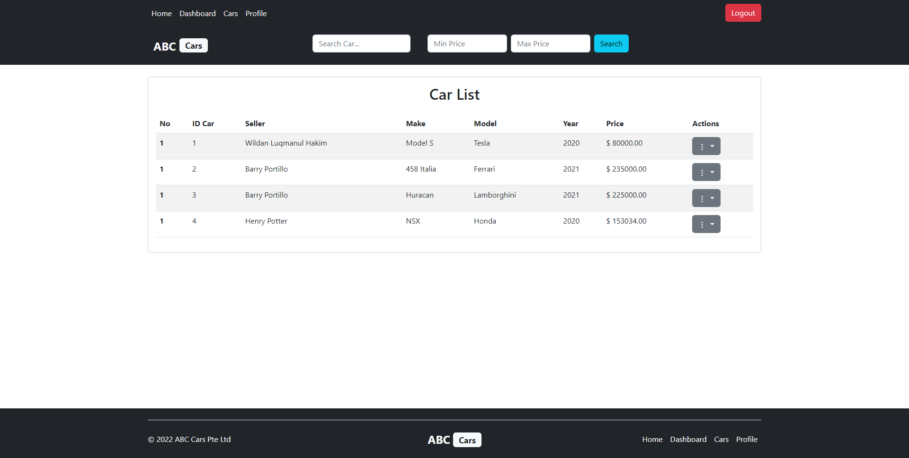
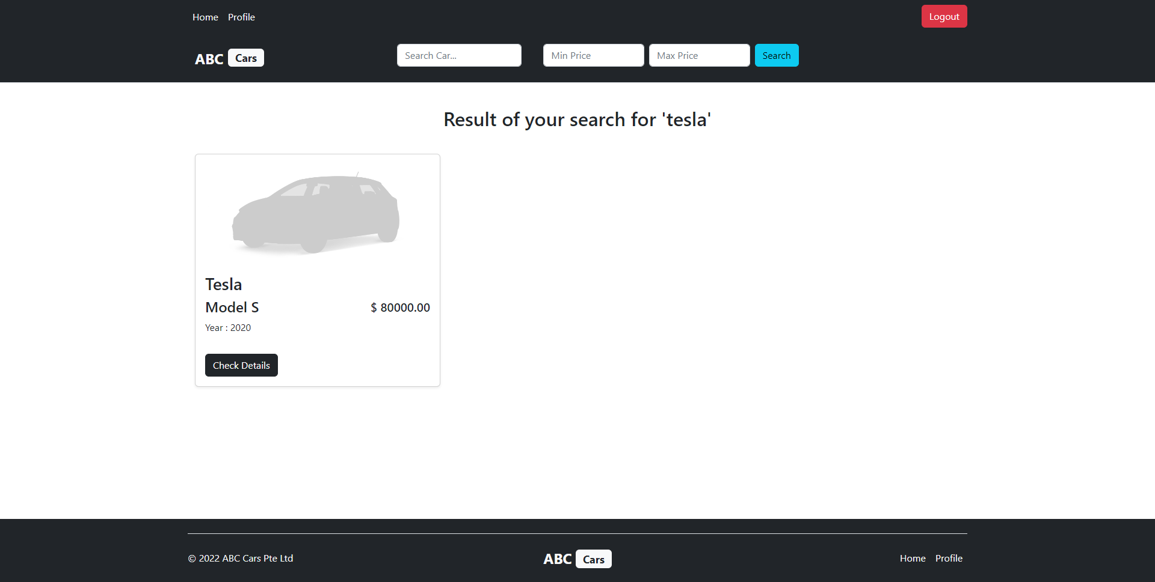
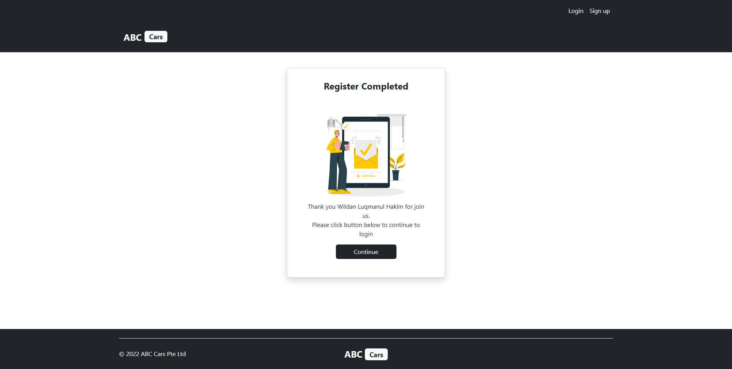
14. Project Results
Search Car Page
Car List Page
Thank You Page

Slide 24
Thank you

